Slide 1
AME 20216 Lab I
Lab Rules, Policies, and Procedures

Slide 2
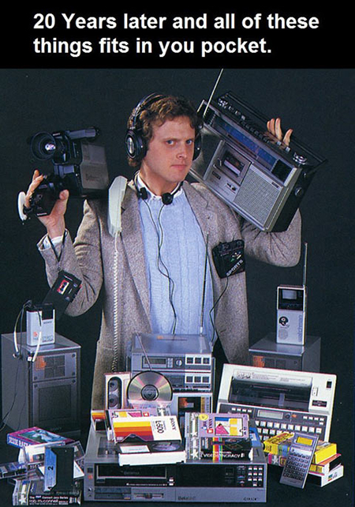
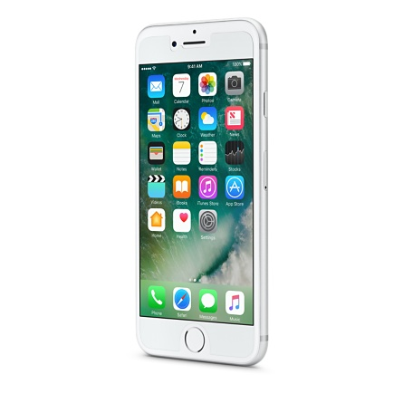
NO CELL PHONES IN LAB OR LECTURE!
https://www.nytimes.com/2017/01/09/well/live/hooked-on-our-smartphones.html
https://www.wsj.com/articles/how-smartphones-hijack-our-minds-1507307811
http://www.foxnews.com/health/2018/01/12/teen-cell-phone-addiction-how-bad-has-it-gotten.html
http://www.cnn.com/2017/11/30/health/smartphone-addiction-study/index.html

Slide 3
COVID-19 Protocols
Wash hands upon entering the lab.
Put on nitrile gloves after washing hands.
Sanitize lab bench and equipment with alcohol wipes after performing the lab.
Wear a mask at all times during lab.

Slide 4
COVID-19 Policies
Email screenshot of Red Pass to Prof. Rumbach and get tested.
COVID Positive: Equipment will be sent to you in Quarantine via campus mail.
COVID Negative: Email me to schedule a make-up lab ASAP.
If you miss more than 3 of the first 7 weeks, we recommend you drop the course.

Slide 5

Lab Safety
EVERYONE MUST SIGN ACKNOWLEDGMENT FORMS
Personal Protective Equipment (PPE)
Safety Glasses
Emergency Action Plan
Fire
Tornado
Chemical Spill Kit
Floor-Dry
Absorbative Blanket

Slide 6
Lab Rules
Leave the equipment as you found it.
Disconnect all wires and cables.
Sanitize Equipment
Tech memos, lab reports, plots, and other deliverables are to be produced individually.
No cell phones in lab.
No food or drink in lab.
Wear safety glasses, lab coats, and/or closed toed shoes when specified by the lab instructor.
Read the handout before lab.
The instructor must sign your lab notebook before you leave.
Show up to lab on time.
No make-up labs unless you present the instructor with an official university excuse. For COVID health checks, send a screen shot of the RED, then go get tested.

Slide 7
NO PENCILS
PENS ONLY
NO PENCILS
PENS ONLY

Slide 8
Policies and Procedures
Late to lab, receive 50% deduction on notebook score.
More than 20 minutes late to lab, receive ZERO for lab notebook score.
Include everyone on ALL emails(the Lab TA, Prof. Rumbach, and Prof. Ott)
Late assignments will receive a deduction of 30% off each working day that they are late.

Slide 9
Lab Reports and Tech Memos
Deliverables can be found at the end of every lab handout.
Labs performed in groups of 2, deliverables should be done individually
Tech Memos and Reports uploaded as PDF files on Sakai
It is your responsibility to make sure your assignments upload properly to Sakai
Technical difficulties must be reported to Rumbach and OIT immediately

Slide 10
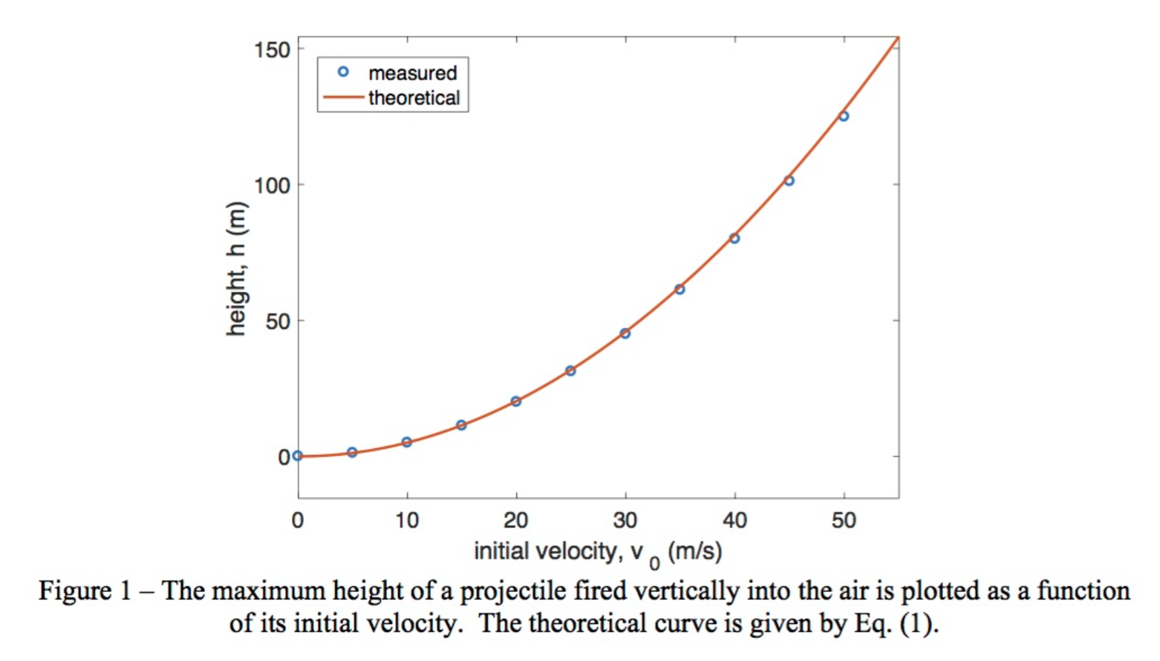
Plots (See HW1)

Slide 11
Schematics
Figure 2 - Schematic of electrospinning. An electric field is applied to a polymer solution being ejected at a constant rate in the direction of a grounded target. The polymer solution is carried through air by an electric field to become fine fibers that are deposited on a rotating and/or translating mandrel to produce a fibrous mesh.
Sill TJ & von Recum HA. Biomaterials (2008).

Slide 12
Tables
Tables should have…
Table captions above the table
Black text on white background
Same font as rest of document
Units should be given if applicable
Include reference number next to value you did not measure.

Slide 13
Academic Honor Code
Common Violations:
Copying exams/quizzes
Copying text from another student’s report or lab handout
Copying figures from another student’s report or lab handout
Using another student’s Matlab code
Posting answers to websites like chegg.com or course hero
Lying about technology problems to obtain more time to work on an assignment
These will not be tolerated.
Violators will be handed over to the Dean.

